Slide 1
AuraDB Knowledge Graph Creation
Kārlis Dīriņš

Slide 2
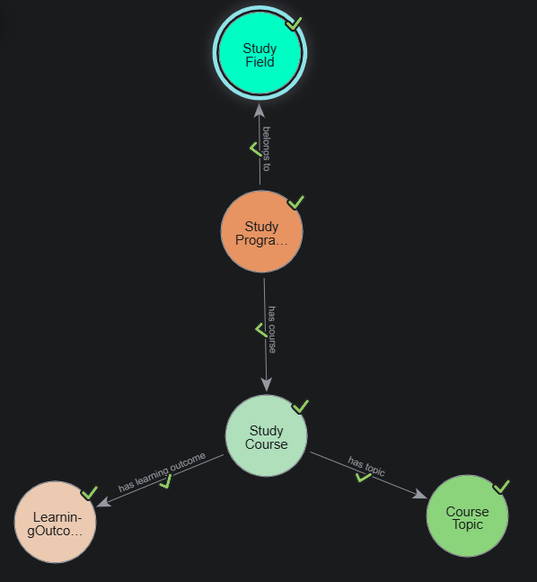
Knowledge Graph Schema created in AuraDB

Slide 3
Queries

Slide 4
Query 1
The first query returns each study programme with its courses and includes the course ID, course title, credit points and course section.
MATCH (p:StudyProgram)-[r]->(c:StudyCourse)
RETURN
p.title AS Programme,
c.course_id AS Course_ID,
c.title AS Course,
r.credit_points AS Credit_Points,
r.section_name AS Section
ORDER BY Programme, Course;

Slide 5
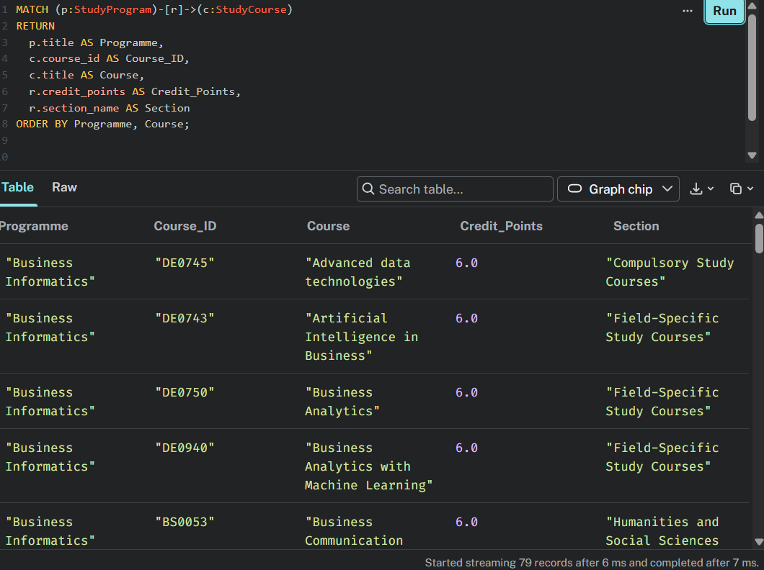
Query 1 result
Note: All returned records are not included in the screenshot as they would not fit in the screenshot

Slide 6
Query 2
Query 2 counts the number of topics for each course and displays the courses with the highest count of topics first.
MATCH (c:StudyCourse)-[:`has topic`]->(t:CourseTopic)
RETURN
c.course_id AS Course_ID,
c.title AS Course,
count(t) AS Number_of_Topics
ORDER BY Number_of_Topics DESC;

Slide 7
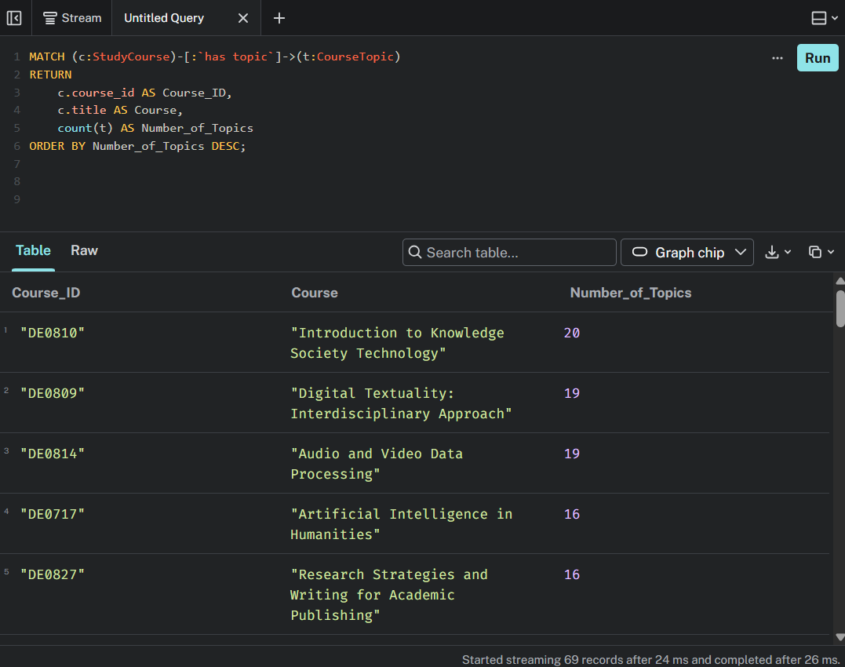
Query 2 result
Note: All returned records are not included in the screenshot as they would not fit in the screenshot

Slide 8
Query 3
Query 3 retrieves all the topics for «Advanced Data Technologies» course and displays them in the defined order.
MATCH (c:StudyCourse)-[:`has topic`]->(t:CourseTopic)
WHERE c.course_id = 'DE0745’
RETURN c.course_id AS Course_ID,
c.title AS Course,
t.ordinal AS Topic_Number,
t.title AS Topic
ORDER BY t.ordinal;

Slide 9
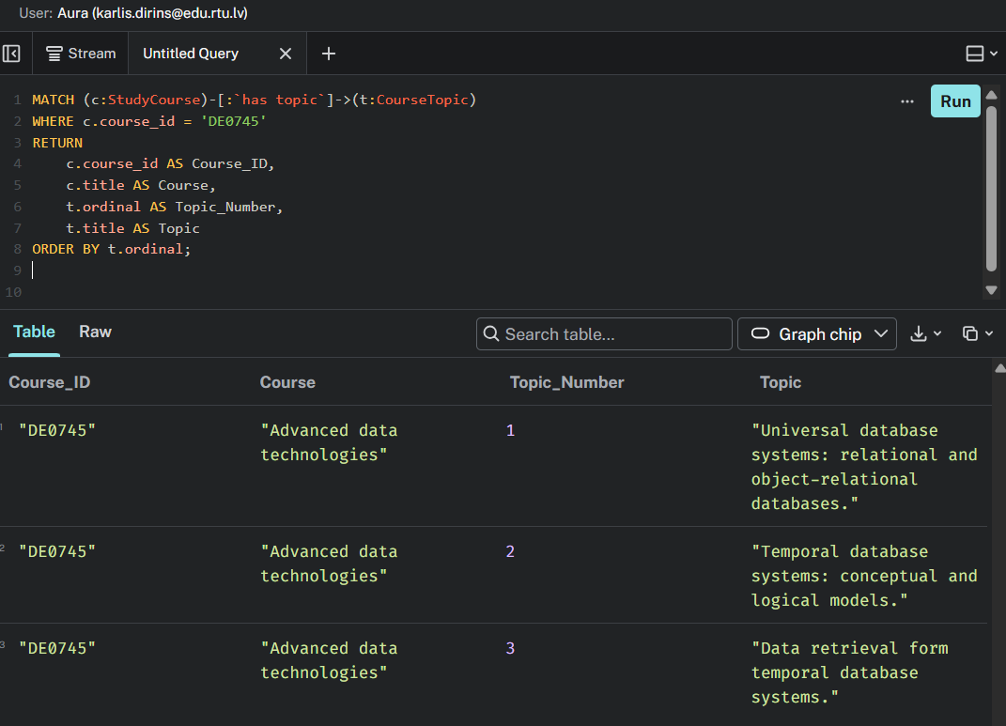
Query 3 result

Slide 10
Query 4
Query 4 retrieves all the learning outcomes for «Advanced Data Technologies» course and displays them in the defined order.
MATCH (c:StudyCourse)-[:`has learning outcome`]->(lo:LearningOutcome)
WHERE c.course_id = 'DE0745’
RETURN c.course_id AS Course_ID,
c.title AS Course,
lo.ordinal AS Outcome_Number,
lo.text AS Learning_Outcome
ORDER BY lo.ordinal;

Slide 11
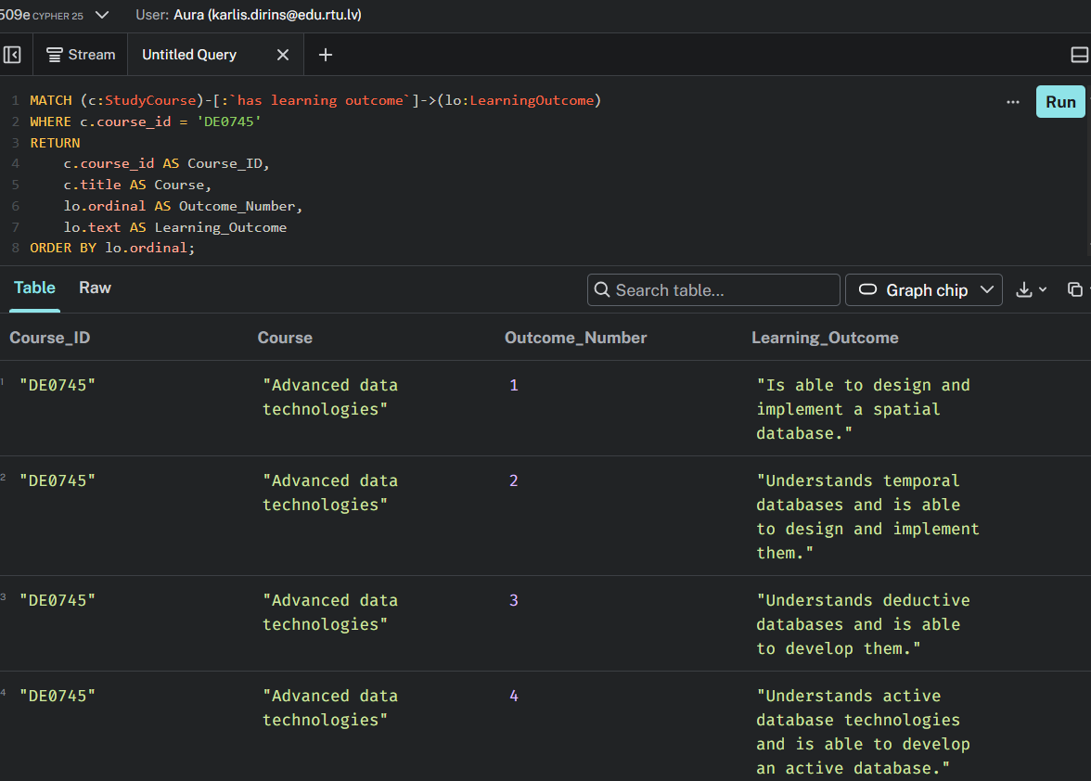
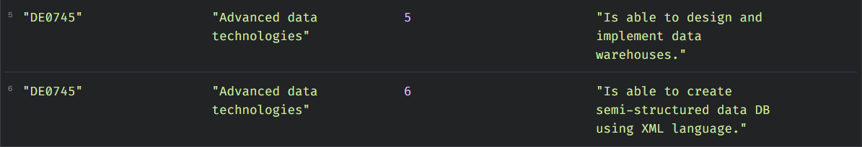
Query 4 result

Slide 12
Thank you!

